Slide 1

STUDENT NAME: BALAJI.K
REGISTER NO AND NMID: asanm20124132010500121019 DEPARTMENT: BCA
COLLEGE: ARIGNAR ANNA GOVERNMENT ARTS AND SCIENCE COLLEGE VILLUPURAM/ ANNAMALAI UNIVERSITY
1

Slide 2
"Personal Portfolio Website for a College Student"
2

Slide 3



Problem Statement
Project Overview
3.End Users
4.Tools and Technologies 5.Portfolio design and Layout
6.Features and Functionality
7.Results and Screenshots 8.Conclusion
9.Github Link
3/21/2024
3

Slide 4



In today' s competitive academic and job environment,
college students need an effective way to showcase their skills, projects, and achievements beyond just a resume.
Traditional resumes fail to demonstrate creativity, interactivity, and digital presence.
Therefore, a personal portfolio website is required to provide a professional online identity and serve as a digital resume for employers, professors, or collaborators.
4

Slide 5




This project is a responsive and interactive portfolio
website developed using HTML, CSS, and JavaScript.
It highlights a student' s profile, skills, academic projects, and contact details in a structured, user-friendly layout.
The website acts as a professional digital platform where recruiters, teachers, or peers can learn more about the student' s background, skills, and projects.
5

Slide 6
College Students – to showcase their academic and technical work.
Recruiters/Employers – to evaluate student' s skills and projects. Professors/Mentors – to assess student' s achievements.
Peers/Collaborators – to connect for group projects, hackathons, or startups.
6

Slide 7


Frontend Technologies:
Design Principles:
HTML5 → for website structure.
CSS3 → for styling and responsive design.
JavaScript → for interactivity (buttons, form handling).
Development Tools:
Responsive web design (mobile-friendly).
Grid and flexbox layouts.
Consistent color palette and typography
Code Editor (VS Code / Sublime Text).
Browser (Chrome/Edge/Firefox) for testing.
7

Slide 8



The website is divided into structured sections:
Header & Navigation → Logo + Menu links (About, Skills, Projects, Contact).
Hero Section → Student introduction, tagline, "Hire Me" button.
About Section → Student background, interests, and aspirations.
Skills Section → Grid-based cards for programming and technical skills.
Projects Section → Portfolio of completed projects with descriptions.
Contact Section → Simple contact form (Name, Email, Message).
7. Footer → Copyright and credits.
8

Slide 9


✅ Responsive Design –
✅ Interactive Buttons –
Works on mobile, tablet, and desktop.
"Hire Me" button triggers a pop-up alert.
✅ Contact Form –
Allows visitors to send a message.
✅ Skills Grid –
Displays student' s technical skillset visually.
✅ Project Showcase –
✅ Modern UI/UX –
card-based layout.
Highlights academic and personal projects.
Gradient hero section, hover effects, and
✅ Easy Customization –
Text, skills, and projects can be edited easily.

Slide 10


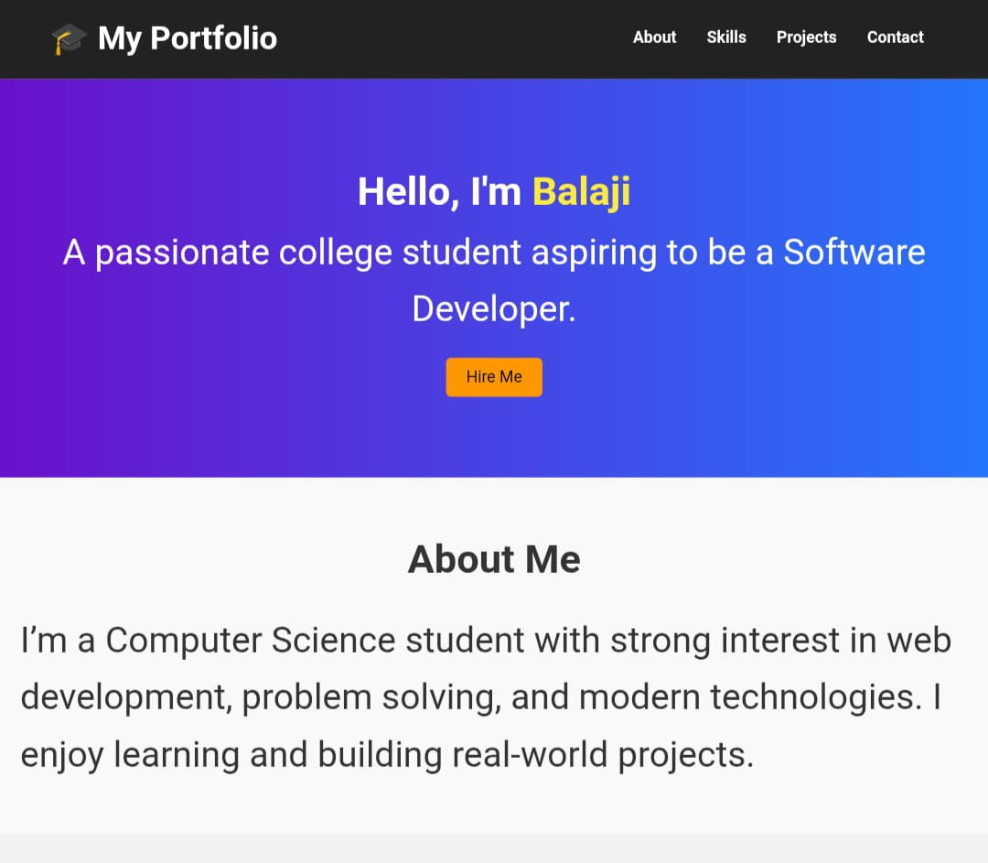

3/21/2024
10

Slide 11
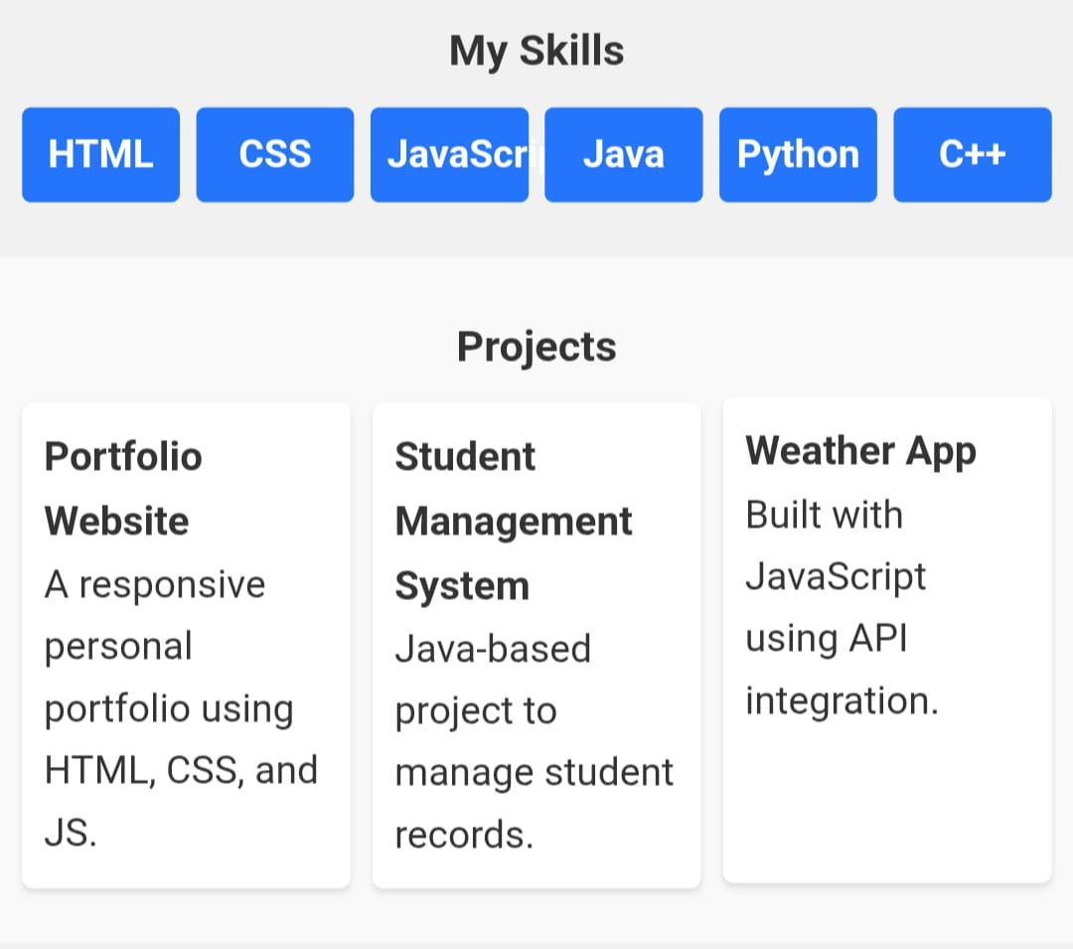

Slide 12
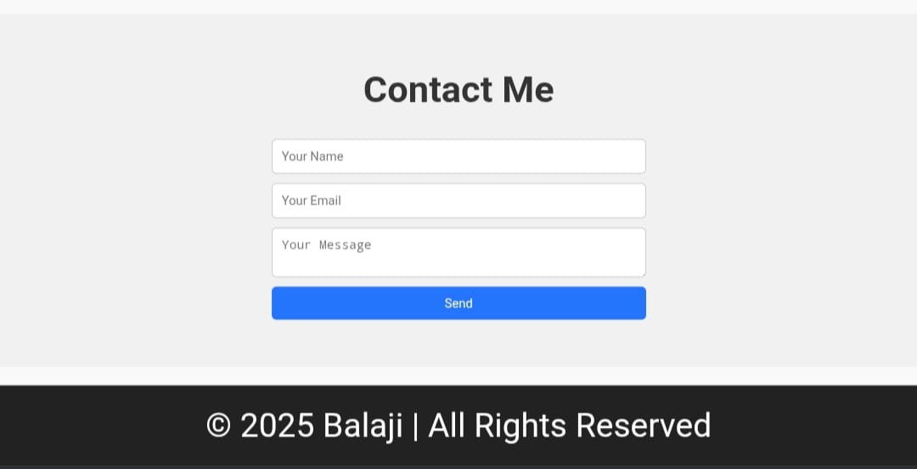

Slide 13

The Student Portfolio Website is a practical and
professional solution for students to showcase their skills, projects, and achievements in a digital format. It helps bridge the gap between students and recruiters, enhancing job opportunities, internships, and collaborations.
With its simple yet modern design, it demonstrates both technical skills and creativity, making it a valuable addition to a student' s academic journey.
11

